Slide 1

Professional Practices

Slide 2
Introduction
Association for Computing Machinery (ACM) and Institution of Electrical and Electronics Engineers Computer Society (IEEE-CS) recommended Professional Practices course for computing professionals.
Cooperate Lessons from Holy Quran relevant to Professional Practices and Code of Ethics by ACM and Software Engineering (SE) will be taught in detail.
Enable the students to identify/solve situations related to ethical conflicts by knowing Code of Ethics and basic concepts of Professional Practices.

Slide 3
Professional Practices
Professional Practices is partly comprised of what a professional should or should not do in the work-place
If a professional is to have ethics then that person needs to adopt that conduct in all of his dealings
Another aspect is the enhancement of the profession and the industry within which the professional works

Slide 4
Professional Practices
Professional Practices is a discipline aimed at: -
Understanding the moral values that ought to guide engineering/computing profession or practice.
Resolving moral issue in computing/engineering.
Justifying the moral judgment in computing/engineering.

Slide 5
Professional Practices
It deals with moral problems and issues connected with computing and engineering.
Another important goal is to discover the set of justified moral principles or obligations, rights and ideals and apply them to ethical situations.

Slide 6
An Educational Challenge
In 1992, Peter Denning [Denning 1992] wrote
“Employers and business executives complain that graduates lack practical competence. Graduates, they say, cannot build useful systems, formulate or defend a proposal, write memos, draft a simple project budget, prepare an agenda for a meeting, work on teams, or bounce back from adversity; graduates lack a passion for learning. They say the current concepts-oriented curriculum is well suited for preparing research engineers, but not the practice-oriented engineer on which their competitive advantage increasingly depends.”

Slide 7
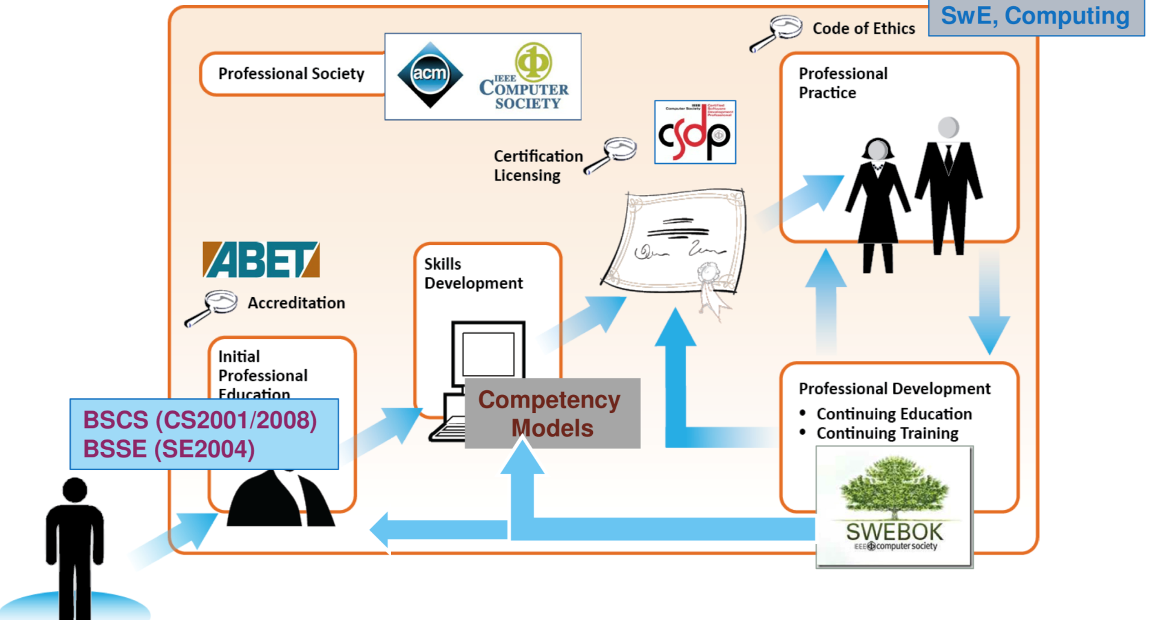
How does one become a Professional?

Slide 8
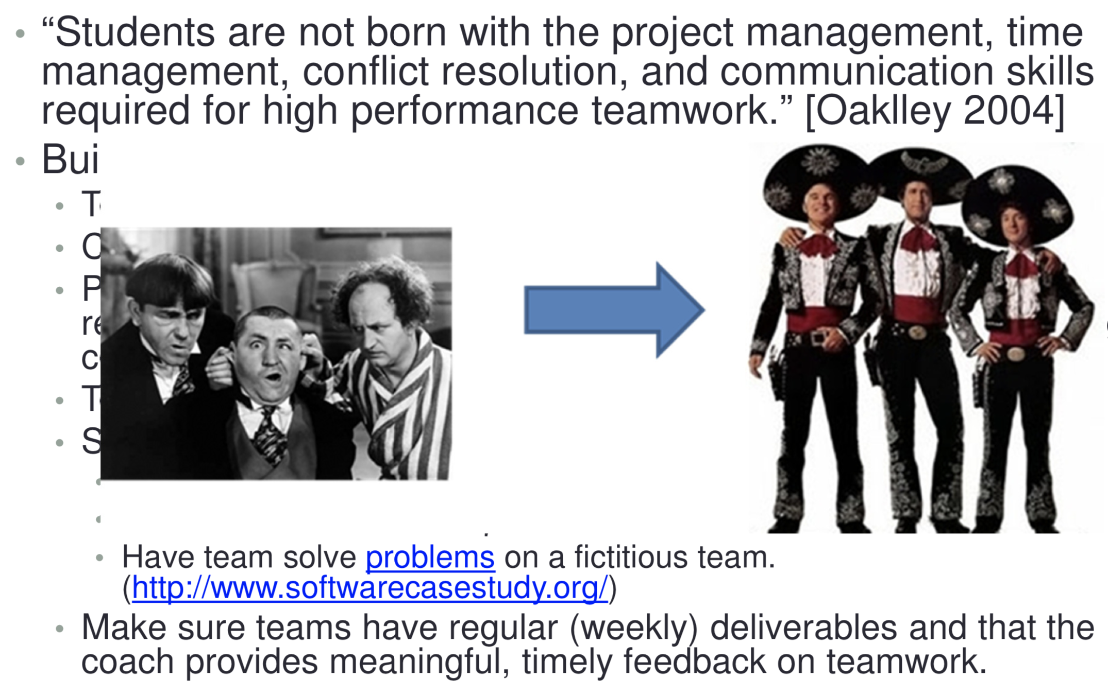
Ability to Function on a Team

Slide 9
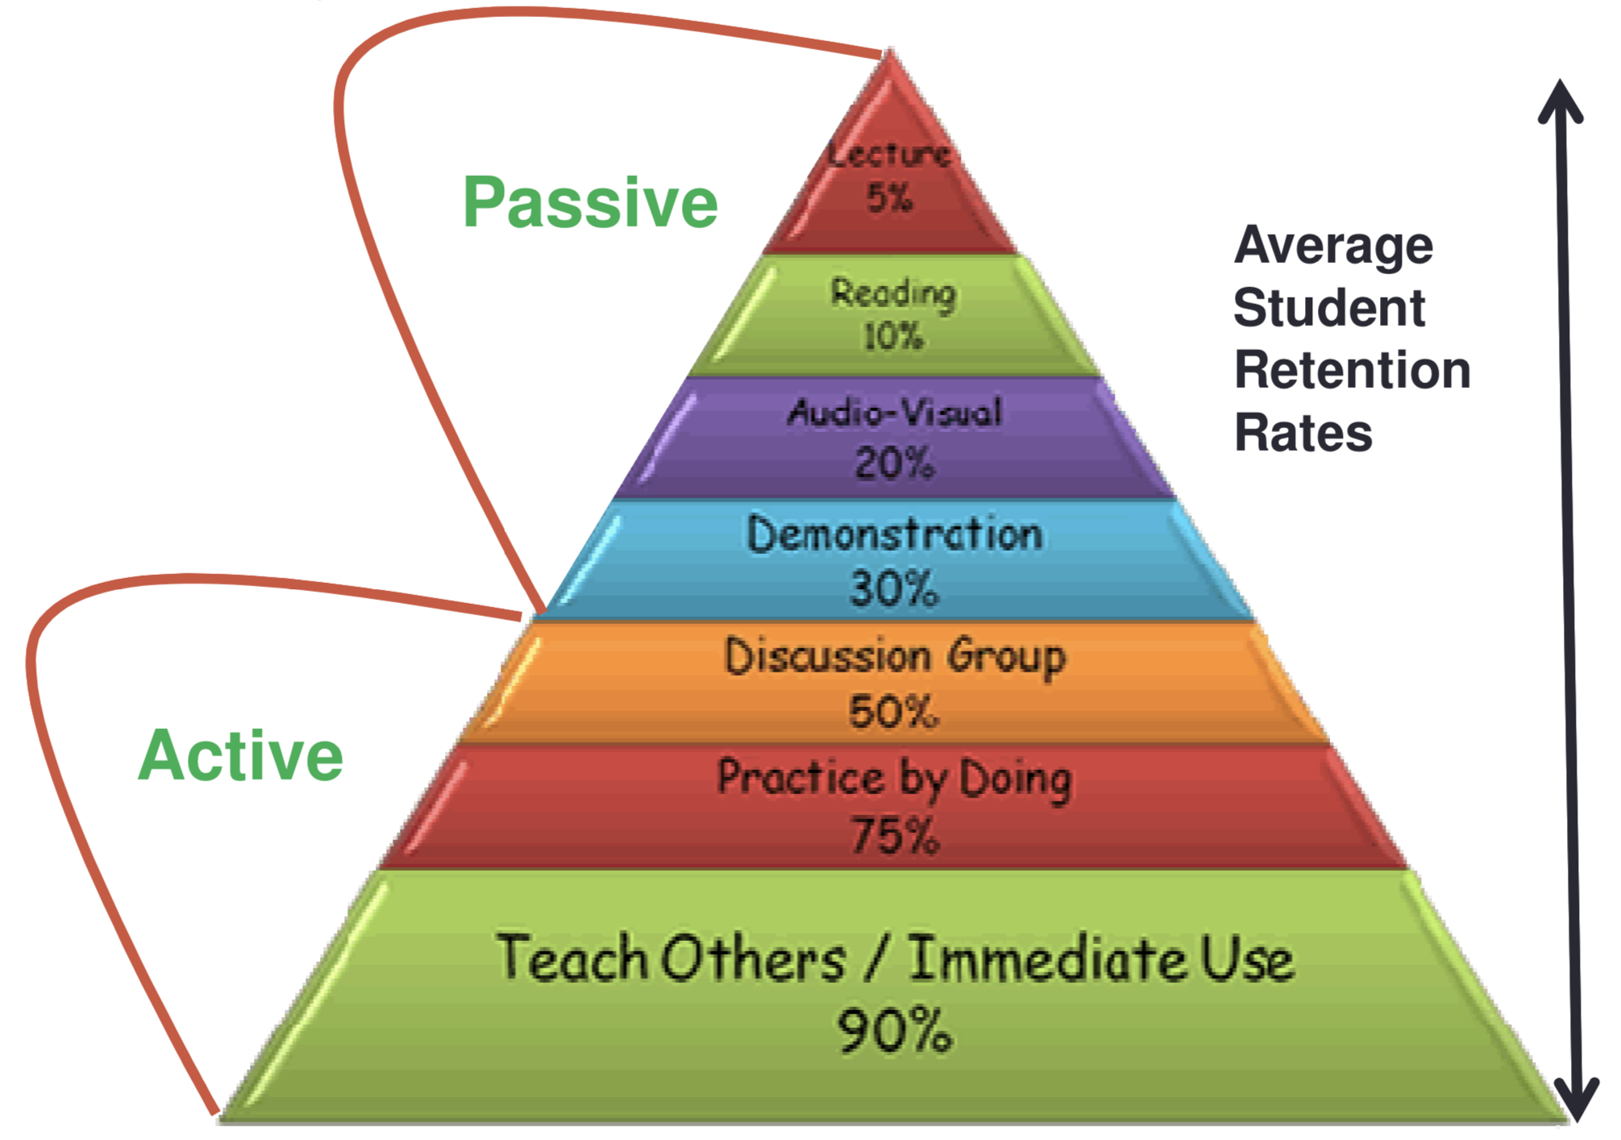
Educating Problem Solvers

